Slide 1
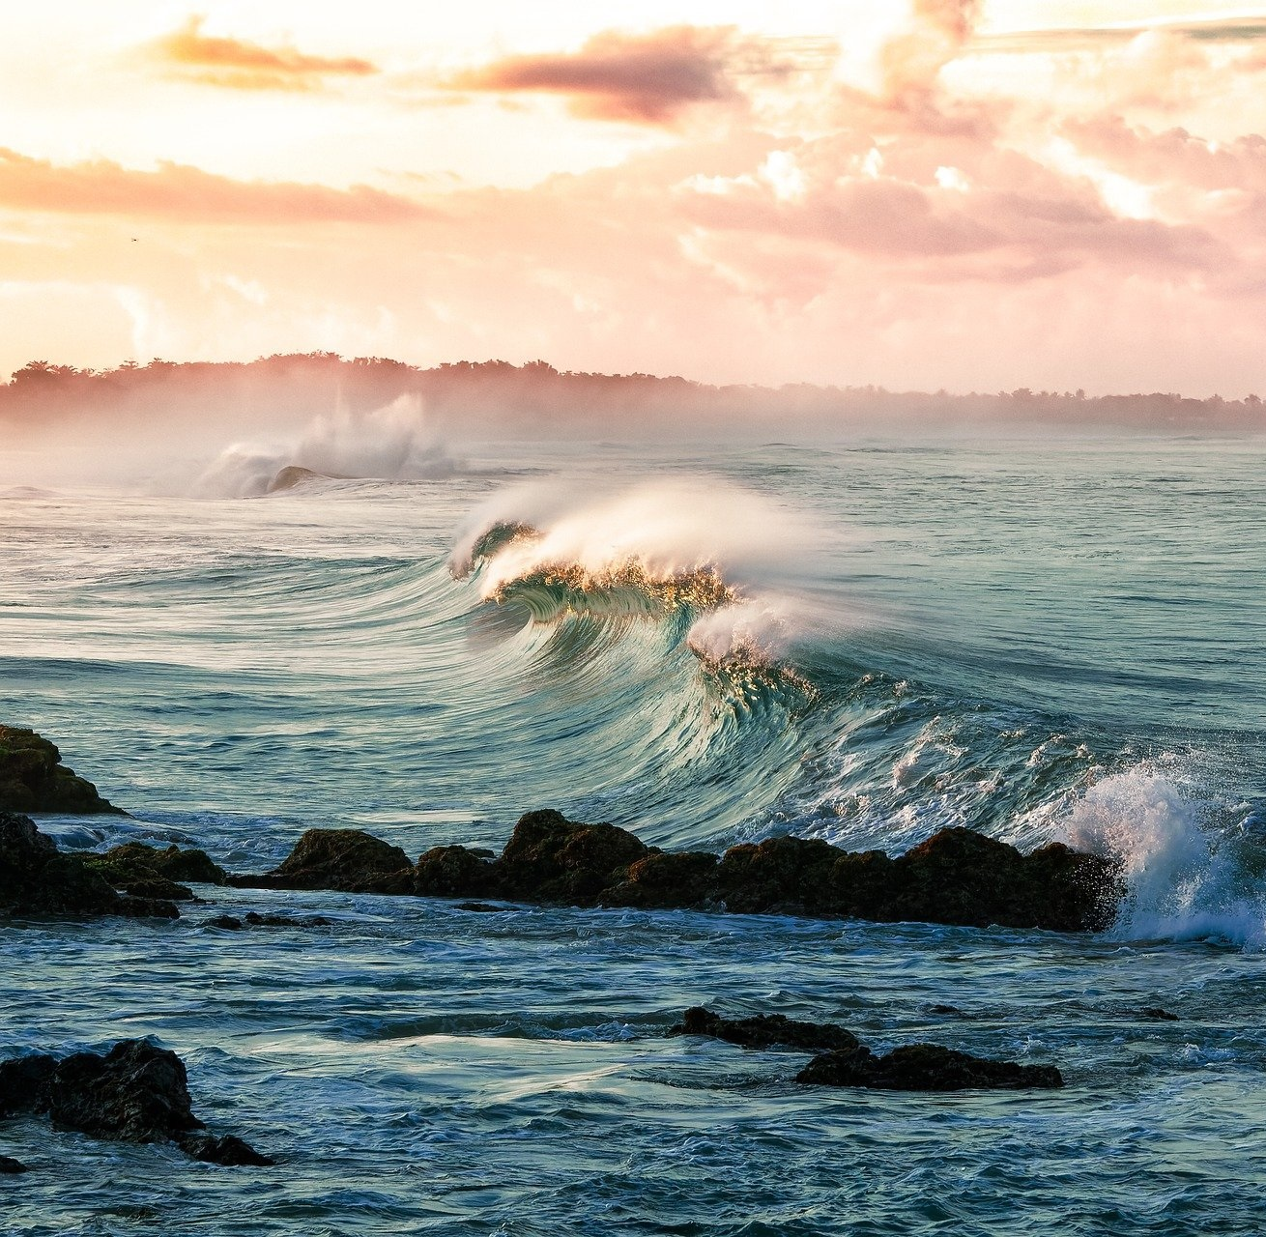
Financing coastal protection in Medmerry, UK
What is the problem?
The area has been used extensively for intensive agriculture. This situation, together with the rise in sea level, has made Medmerry - until ten years ago – at high risk of flooding from the sea
What is the solution?
The Medmerry scheme aimed at realigning a section of coast to better protect it from floods. This was achieved by creating a 7km-long new seawall .
What is the objective?
The objective of the project was to provide protection from coastal flooding for local people and provision of habitat for nature
What are the benefits?
Environmental benefits
Creation of 184 hectares of new intertidal habitats, giving a new habitat to many species
Flood prevention
Social benefits
Protection of 364 homes previously under threat
Increased recreational activities, through new footpaths, cycle paths, horse-riding routes
Economic benefits
Increased value for the local fisherfolk
Boost to the local economy from an increase in green tourism
Net increase in ecosystem service provision (excluding flood protection) was estimated to be £3.0m per year (from tourism and recreation, climate regulation, food, and the provision of coastal habitats)

