Slide 1
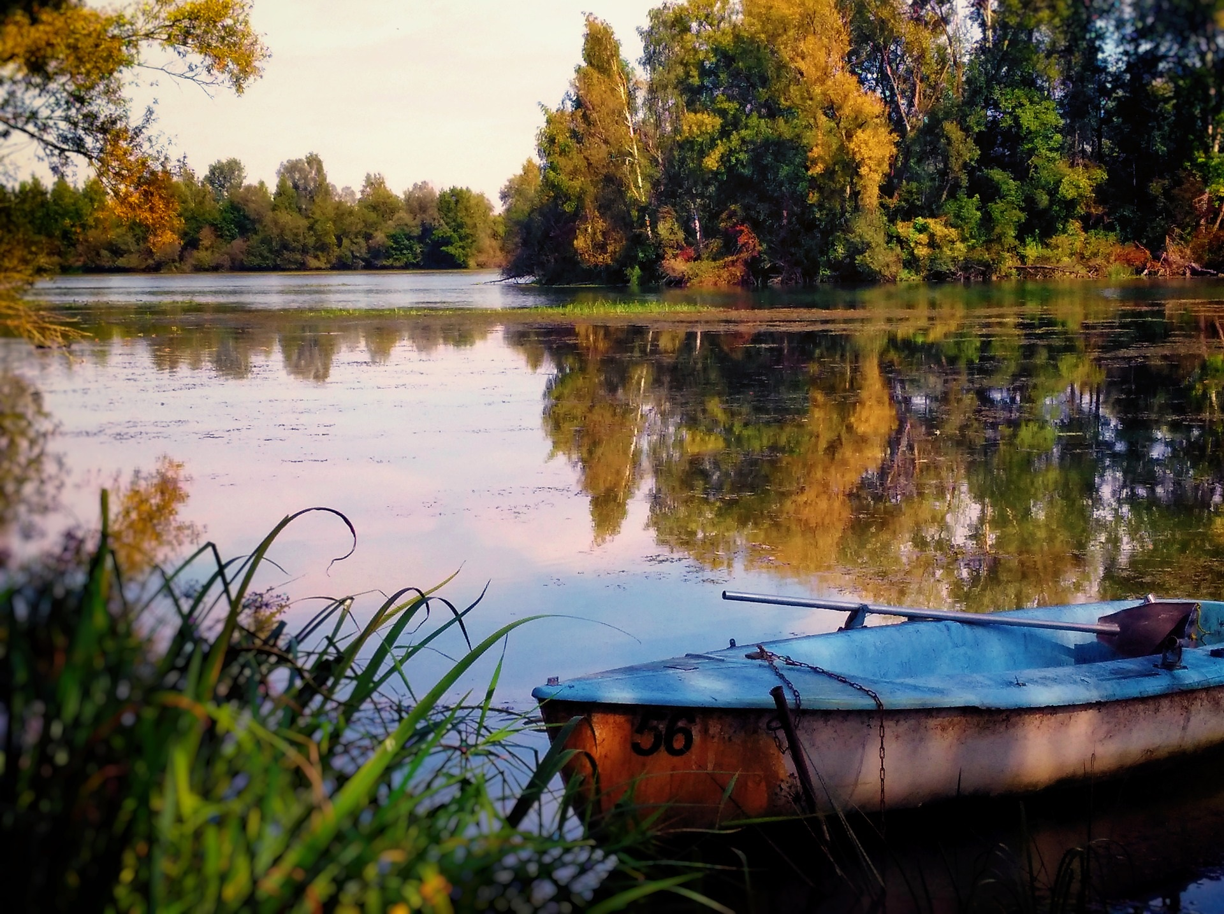
Restoration of the Isar River Basin, Germany
What is the problem?
The Isar River has high discharge variability throughout the year influenced by snowmelt in the mountains in spring, high annual precipitation, and regular orographic lifting situations with resulting intense rainfall and major flood events
What is the solution?
As part of the PHUSICOS project, in order to reduce such hydro-meteorological risks, 8 km of the river were restored in the city through collaborative planning and a co-design approach
What is the objective?
The objective of the project was to decrease flood risks and the river incision rate, improve recreational quality and ecological status
What are the benefits?
Environmental benefits
Enhanced flood protection
The restored riverscape can handle 100 year flood events without damage to the city
The restored river can now mitigate a 1,200 m³/s flood
Creation of a variety of new habitats typical in and along alpine rivers
Social benefits
Creation and improvement of outdoor recreation opportunities
Public participation in the project with over 100,000 citizens involved with workshops, collecting ideas, providing information
Economic benefits
New and enhanced sources of income through more and better recreation opportunities along the river.
Increased real estate value compared to other river sections

