Slide 1
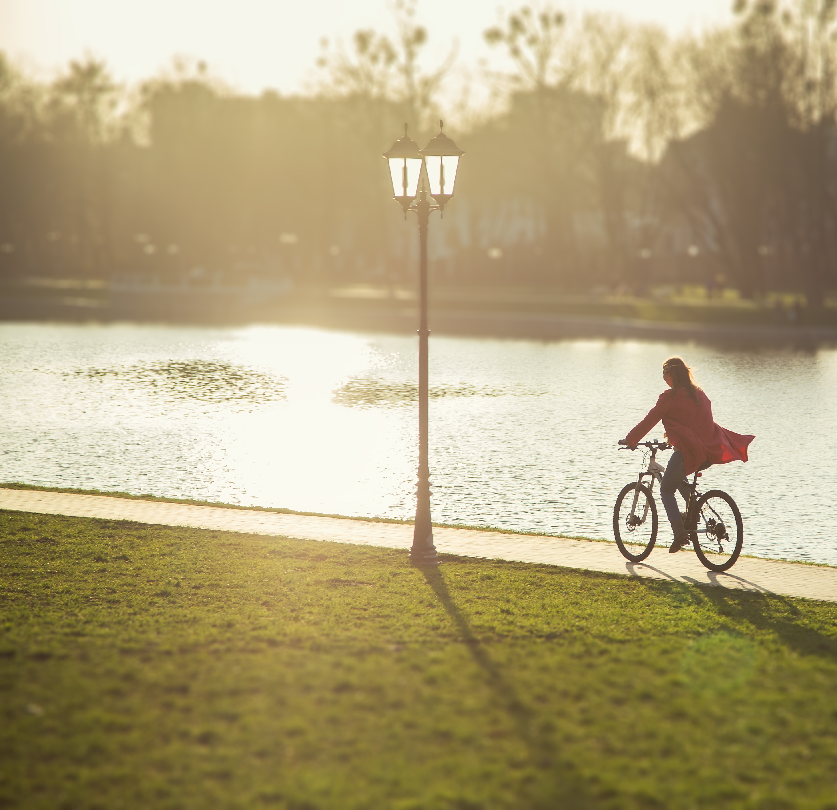
Urban parks for water management in Åarhus, Denmark
What is the problem?
The area is subject is heavy rainfalls
What is the solution?
The SPARK project contributes to the world's first city park that handles excess rainwater and supports healthy lifestyles. The project comprises the installation of parks and (semi) natural urban green areas with sustainable urban drainage systems in Aarhus, around the Marselisborg Rehabilitation Center, for water management.
What is the objective?
The objective of the project was to handle excess rainwater and promote healthy lifestyles
What are the benefits?
Environmental benefits
Retainment of 892 m3 of water during a 1/2 year rain event, in which 14,2 mm will fall in 10 minutes
During a 1-in-100 year rain event, the project can handle 3,427 m3 of water
Protection of hospitals and surrounding buildings against floods
Relieving pressure on the local drainage system
Social benefits
Around 15,000 citizens have access to new recreational spaces
Public participation in the project activities with 900 people from local institutions
Establishment of 11 internships and a range of educational workshops
Economic benefits
Creation of local jobs
Increased capacity to facilitate a minimum of 2,500 outdoor rehabilitation courses every year

